Slide 1
Topic-Aware Neural Keyphrase Generation for Social Media Language
Yue Wang, Jing Li, Hou Pong Chan, Irwin King, Michael R. Lyu, Shuming Shi
Department of Computer Science and Engineering
The Chinese University of Hong Kong, HKSAR, China
Tencent AI Lab, Shenzhen, China
ACL 2019
Zhuomin Chen
2021.09.05

Slide 2
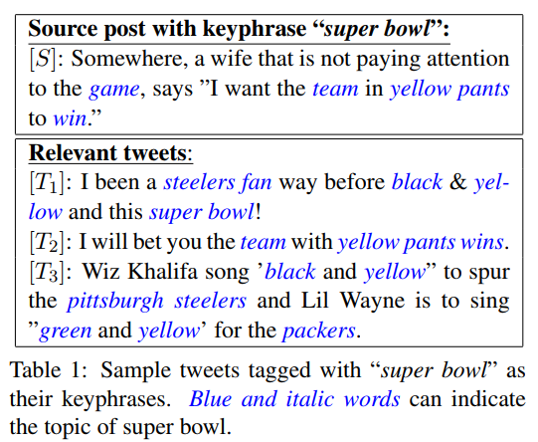
Introduction
Most progress to date has focused on extracting words or phrases from source posts, thus failing to yield keyphrases containing absent words.

Slide 3
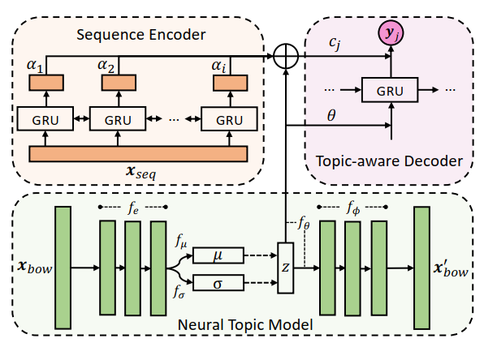
Topic-Aware Neural Keyphrase Generation Model
: each post x into bag-of-words (BoW) term vector
a V -dim vector over the vocabulary (V being the vocabulary size)
: word index sequence vector

Slide 4
Neural Topic Model
BoW Encoder:
is a neural perceptron with an ReLU activated function
BoW Decoder:

Slide 5
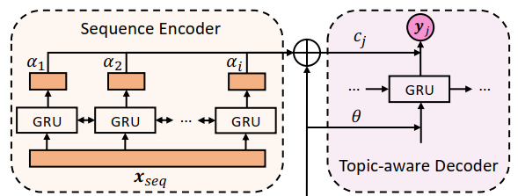
Neural Keyphrase Generation Model
Sequence Encoder：
Memory bank

Slide 6
Neural Keyphrase Generation Model
Topic-Aware Sequence Decoder:
Copy mechanism:

Slide 7
Jointly Learning Topics and Keyphrases

Slide 8
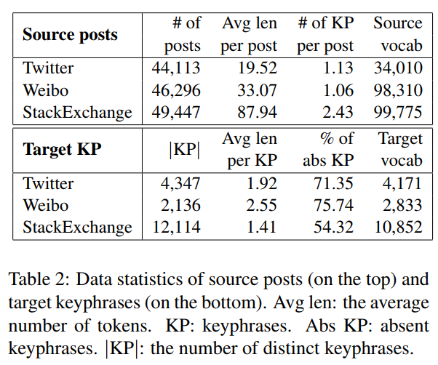
Experimental Results

Slide 9
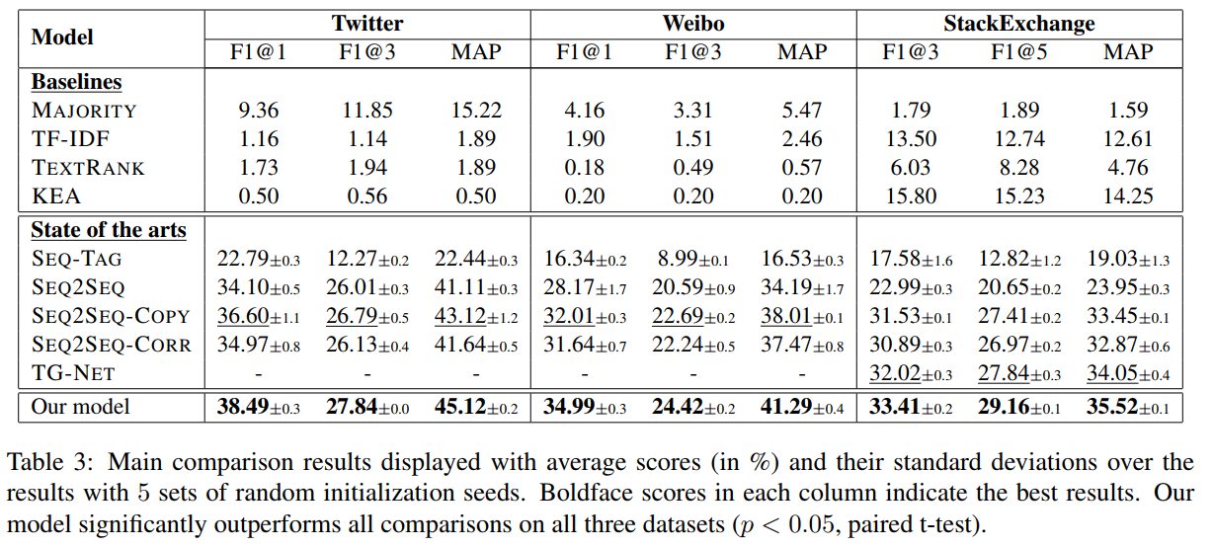
Experimental Results

Slide 10
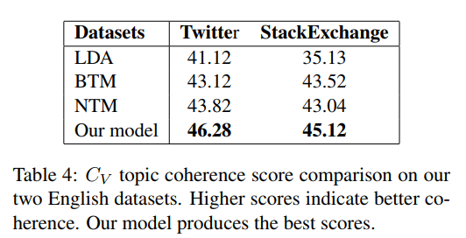
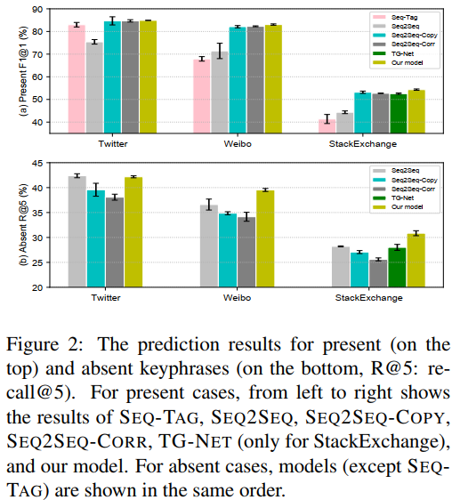
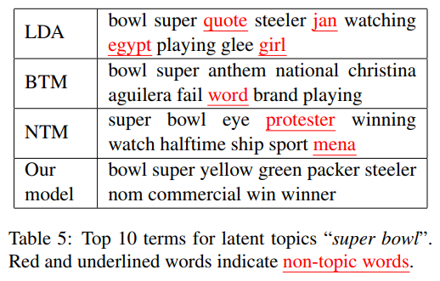
Experimental Results

Slide 11
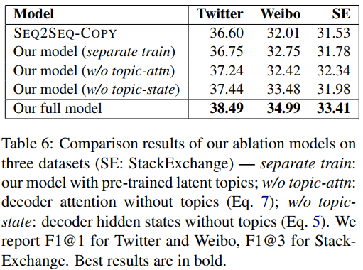
Ablation Study

Slide 12
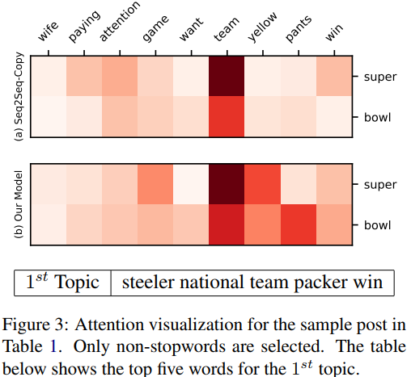
Case Study

Slide 13
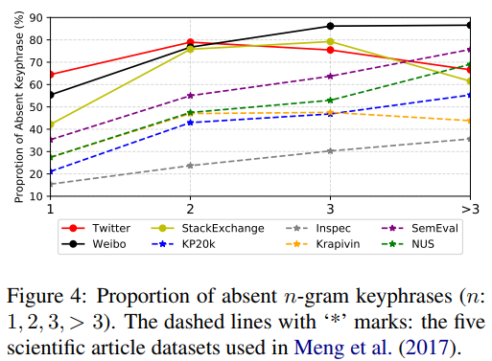
Topic-Aware KG for Other Text Genres

